Slide 1
Budget Analysis: Why and how to estimate costs of production
Kate Binzen Fuller, Ph.D.
Asst. Professor/Extension Specialist
Dept. of Ag Econ & Econ, MSU Extension
Montana State University
With help from: George Haynes and Joe Janzen

Slide 2
Outline
State of Montana’s ag economy and outlook
Currently available budgets
Adjusting budgets for your operation
Weighing options moving forward

Slide 3
Montana total cash receipts, 1995–2017
Notes:
Chart from George—October 2017.

Slide 4
Dismal stats on the crop side
Since 1900, June–Sept 2017 was:
The 9th driest for major MT wheat production areas
The 2nd driest for NE MT
In 2017:
32% reduction in wheat production overall
41% reduction in winter wheat production
Only 11% spring wheat rated good/excellent
Notes:
From Anton’s Outlook slides

Slide 5
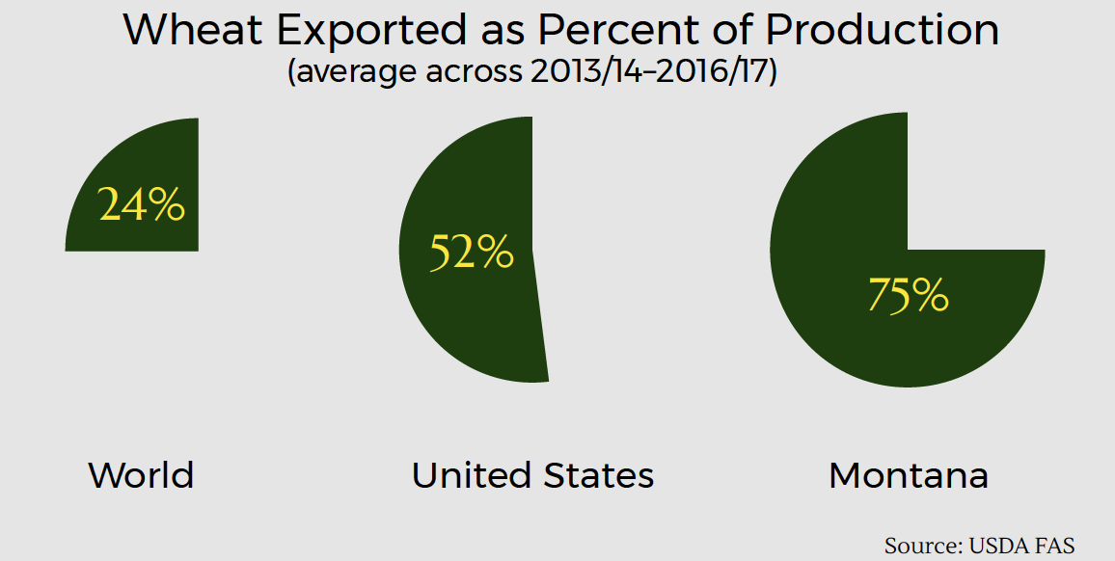
Why didn’t wheat prices rise?
Global production very strong
Stocks are huge
Notes:
Russia breaking records year after year, EU very strong

Slide 6
Pulses: Also a global market
US exports 50-75% of its pulse crop production
India = most important customer
Fumigation derogation extended (?)
New import pea tax
Food aid is an important outlet, esp. for low quality peas and lentils
US Dry Pea (outside) and Lentil (inside) Exports by Destination, 2011-2015
Source: USDA Foreign Agricultural Service

Slide 7
Cattle: Uncertainty 2018 CME Futures Prices ($/hundred pounds, no basis adjustments – 1/5/18)
 | Nearby | Sept/Oct
Feeder Cattle | 146 | 145
Live Cattle | 119 | 111
Notes:
http://www.cmegroup.com/trading/agricultural/livestock/feeder-cattle.html, reporting prev. settlement prices
http://www.cmegroup.com/trading/agricultural/livestock/live-cattle.html

Slide 8
Montana’s Agricultural Economy: 2018 and Beyond
(December) WASDE Price Forecasts
Wheat: $3.89 ↑ $4.50-4.70/bu
Steers: $121 ↓ $113-122/cwt
(August) FAPRI Price Forecasts
Wheat: $3.89 ↑ $4.80/bu, <$5 for next 3 years
Steers: $122 ↓ $111/cwt, flat for next 3 years
Notes:
Wheat (16/17-17/18)
Steers (‘17-’18)

Slide 9
Ag Economy Barometer
Ag Economy Barometer: 80% of producers expect ag rental rates to remain unchanged in 2018

Slide 10
Looking forward: Unknowns
Farm and ranch response to 2017
De-globalization, other ag policy
Weather

Slide 11
What could I have done better?
Bought crop insurance
Planted less or more of something
Added or subtracted an enterprise
Tried a new method—e.g. adding a cover crop, etc.
Enterprise budgets can help you estimate benefits and costs from changes to your operation.

Slide 12
Enterprise: A specific product produced by the operation (e.g. wheat, peas, calves). Most farms consist of several enterprises.
Enterprise Budget Analysis: Comparison of enterprises, in which some or all of the farm’s projected revenues and costs are allocated to each enterprise.

Slide 13
Sample budget resources
1. Montana Dept. of Agriculture
2. North Dakota State University
3. University of Idaho

Slide 14
Montana DOA sample budgets
agr.mt.gov/Grants/new-2017-montana-pulses-buyers-guide-crop-budget-projection-comparisons-now-available
(Just Google “Montana Crop Budget”)

Slide 15
NDSU sample budgets
www.ag.ndsu.edu/farmmanagement/crop-budget-archive

Slide 16
Idaho sample budgets
www.uidaho.edu/cals/idaho-agbiz/crop-budgets

Slide 17
Projected 2018 Returns Above Direct Costs ($/acre) for Northwest North Dakota
Source: North Dakota State University Extension

Slide 18
Using/modifying available crop budgets
Existing budgets give a good starting point
You and your accountant, lender, extension agent, and others can all adapt these budgets to your specific situation
Costs can vary widely from one farm to another
Learn about assumptions behind sample budgets

Slide 19
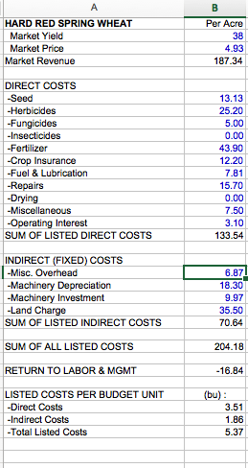
Spring Wheat

Slide 20
Budget items
Revenue
Seed
Herbicide
Insecticide
Fertilizer
Crop insurance
Fuel, lubrication, repairs
Miscellaneous
Operating Interest
Overhead
Machine Depreciation & Investment
Land charge
Yield
Price
Direct Costs
Indirect Costs

Slide 21
Key concepts for budgeting
Direct versus indirect costs
Direct costs are necessary to produce a specific crop
E.g. Seed, fertilizer, chemical, fuel, some labor
Generally easier to calculate than indirect costs
Indirect costs cannot be easily allocated to specific enterprises
Land, machinery, overhead

Slide 22
Adjusting direct costs
Seed
Herbicide
Insecticide
Fertilizer
Crop insurance
Fuel, lubrication, repairs
Miscellaneous
Operating Interest
Direct Costs

Slide 23
Direct costs, MT winter wheat (incl. fallow)
Source: http://ageconmt.com/winter-wheat-production-budget/

Slide 24
Budget adjustments: Fallow vs. recrop
Moving from wheat-fallow to continuous-crop rotation can:
Lower yields
Remove chem fallow costs
Allow for more efficient machinery usage
E.g. Combine can be used over longer harvest period and more acres
Generate new costs for specialized equipment needed for pulse production
E.g. land roller, flex header
These are allocated only to specific enterprise

Slide 25
Budget adjustments: Fertilizer
Existing budgets assume fertilizer use is considerable lower for pulse crops.
How can we incorporate nitrogen credits in a continuous-crop rotation?
Lower fertilizer cost for non-pulse crops
Improves profitability of continuous crop rotations

Slide 26
Budget adjustments: Fertilizer
www.msuextension.org/econtools/nitrogen/

Slide 27
Budget adjustments: Fuel, lube, and repair--machine costs
Engineering formulas used to estimate:
Fuel (diesel): 0.044 gallon x HP hour
Lubrication: 0.15 x fuel cost
Repair: Set rate per hour of use (see last page of every NDSU budget for list)

Slide 28
Budget adjustments: Fuel, lube, and repair--machine costs
www.extension.iastate.edu/agdm/crops/html/a3-29.html

Slide 29
Budget adjustments: Misc & operating interest
Misc Soil testing, custom work, drying costs, machinery rental, etc.
Operating interest NDSU 2018 estimated at 5.1%*direct costs/6 months

Slide 30
Adjusting direct costs
Direct costs | Per acre
-Seed | 10.00
-Herbicides | 22.40
-Fungicides | 9.00
-Insecticides | 0.00
-Fertilizer | 43.91
-Crop Insurance | 11.30
-Fuel, Lubrication, and Repairs | 23.65
-Miscellaneous | 7.50
-Operating Interest | 3.26
SUM OF LISTED DIRECT COSTS | 131.02
Seed
Herbicide
Insecticide
Fertilizer
Crop insurance
Fuel, lubrication, repairs
Miscellaneous
Operating Interest
Direct Costs

Slide 31
Adjusting indirect costs
Overhead
Machine Depreciation & Investment
Land charge
Indirect Costs

Slide 32
Budgeting Adjustments: Depreciation
Depreciation
Annualized cost of purchasing equipment, etc.
Simple (straight-line) depreciation =
(current value – salvage value)/useful life
Total Depreciation to Allocate
Current Value ($)
Initial Cost
Salvage Value
Time (Years)
Useful Life

Slide 33
Budget adjustments: Overhead
Overhead
Can mean many things—often:
machinery housing
various insurance
vehicle licensing
utilities
tax prep
office expenses
Often calculated as a formula
(NDSU:
Overhead=1.35%*Average machine value + $4*acres + liability ins. + truck licensing)

Slide 34
Budget adjustments: Machinery investments
Machinery Investment Cost = 4.5%*Average Machine Value
Measures the opportunity cost of machine purchase
What’s the next best thing you could have done with money used to buy machinery?

Slide 35
Budget adjustments: Land charge
msuextension.org/aglease/

Slide 36
Rough estimation of indirect costs
Indirect costs in MDA budgets:
25%–50% of total costs
35%-60% of direct costs
Wheat and pulses generally around 55%
Use something in this range to get an idea
Where is labor in this budget?

Slide 37
Adding it all up
Market yield |  | 35
Market price |  | 4.82
Market revenue |  | 168.70
Direct costs |  | Per acre
-Seed |  | 10.00
-Herbicides |  | 22.40
-Fungicides |  | 9.00
-Insecticides |  | 0.00
-Fertilizer |  | 43.91
-Crop Insurance |  | 11.30
-Fuel, Lubrication, and Repairs |  | 23.65
-Miscellaneous |  | 7.50
-Operating Interest |  | 3.26
SUM OF LISTED DIRECT COSTS |  | 131.02
RETURNS ABOVE DIRECT COSTS |  | 37.68

Slide 38
Budgets are a profit projection
Estimate revenues and costs on the basis of what is most likely, not a target or goal
Especially with yields
Some revenue and cost items are known with relative certainty, some are forecasts based on historical data

Slide 39
Budgets are a profit projection
Short run vs. long run
Long run: Are the revenues and cost realistic for several years?
Short run: Omit indirect costs if land and machinery already in place
Focus is return over direct costs

Slide 40
Notes on variability/risk
Diversification has some risk-reducing value
But, there may be a (steep) learning curve
What about crop insurance?
Provides revenue or yield guarantee at a cost
msuextension.org/cropinsurance

Slide 41
So, how did you do?
Things to try:
What if scenarios:
Can be used to calculate breakevens
Benchmarking current and potential enterprises against each other
Explore how adding/changing crop insurance policies affects projected and past revenue years

Slide 42
Linking budgets to cash flow
Combine individual budgets with other sources of revenue and cost (e.g. ARC and PLC)
Remove depreciation and machinery investment, add per acre principal and interest on machinery.
See MT Dept of Ag and NDSU spreadsheets.

Slide 43
Questions?
Kate Binzen Fuller
kate.fuller@montana.edu
406-994-5603

